Slide 1
Method report

Slide 2
Agenda
Previous state
June~August Progress
Next plan

Slide 3

Previous state

Slide 4


We generated some simulated project schedule with all the attributes intact to closely mimic how construction projects are being run. The generated data then preprocessed to make the input for the model. We derived these attributes to be the input variables of the model:
Progress : Percentage of task/project completed
Weekend : Current date is weekend
StartDelay : ActualStartDate - StartDate
DayCount : CurrentDate - StartDate
Delay : ActualEndDate - EndDate
TaskToday : Number of task on going for current date
TaskParent : Length of task dependency chain
Using the above data, we build the prediction model to predict the delayed days of each task in the project with Decision Tree as the base regression model. The model outcomes are the delayed days prediction and the significant factors to the delay.

Slide 5
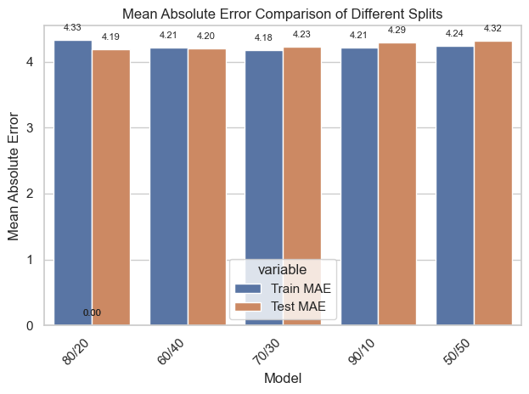
Delayed days can be predicted based on the simulated data, and the model precision is decent. In the chart above we can see the Mean Absolute Error(MAE) of the model is consistent across different dataset splits, which simulates different input conditions. While delayed days prediction is logically correct, that is not the case with the predicting factors.

Slide 6
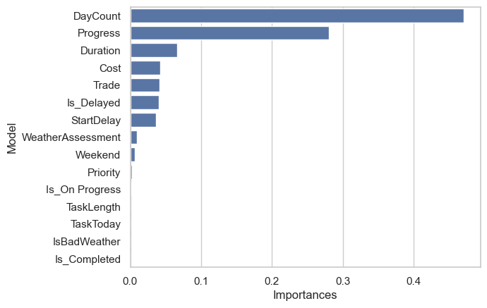
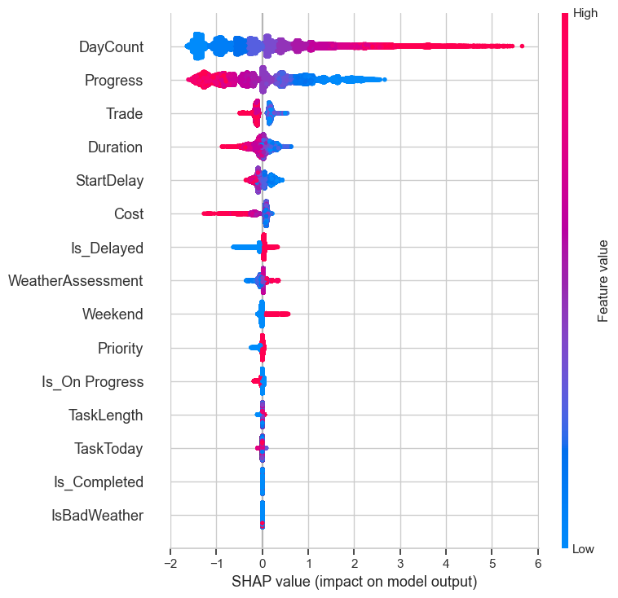
Feature importance result
As shown in the chart above, the most significant factor is the DayCount and Progress which does not make sense in the project scheduling itself. We can understand the SHAP summary plot above can define the significant factors causing the delay, but the factor given is the one needed improvement.

Slide 7

June ~ August Progress

Slide 8
We decided to approach the problem in a different way. We take a look at the generated data again and make sense of it in terms of how it is similar to real-world project schedules.
We change the data structure of the schedule and we went further for the feature engineering part where we conduct more research to determine which feature/data that the most important/related to the delay prediction:
For example we breakdown weather variable with these components:
Wind Speed: Average speed of wind at the location where the task occurred (Km/hr)
Temperature: Average region temperature at the location where the task occurred (C)
Rain Probability: Rain probability at the location where the task occurred (%).
We add some variable/feature to the dataset:
WorkerScore: Worker assessment score based on their previous work, this should be important to understand the capability of the labor to handle the task (0 ~ 100)

Slide 9
We also eliminate some unnecessary or small impact variables such as:
Day count: after some research we decided day count seems not correlated with the possibility of delay
Weekend: have very small impact in overall
Priority, TaskLength & IsOnProgress: We will move this variable to the Sequencing Phase later
Cost: Cost also doesn’t really have correlation with the completion of the task, because even the cost seems sufficient but because of unexpected condition there are some cases that the cost might have to be increased to add labor for example to catch the deadline

Slide 10
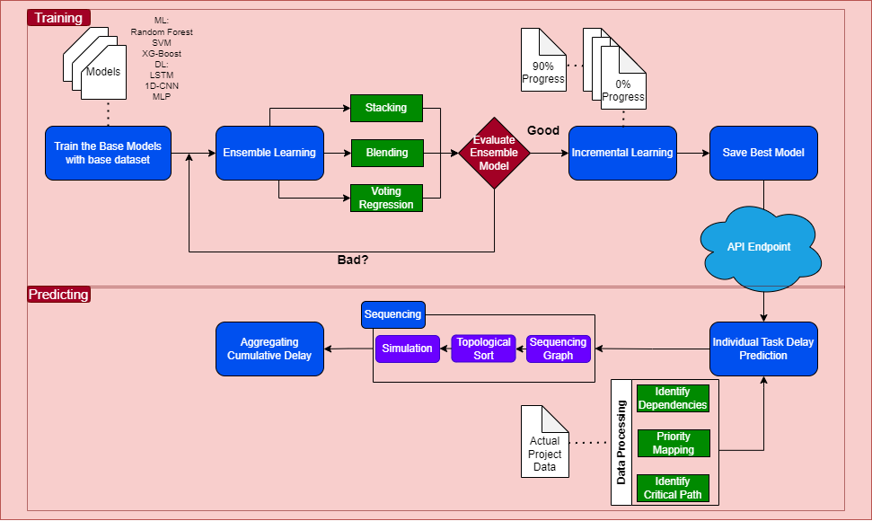
Future model Pipeline

Slide 11
Model evaluation
Previous Best model :
MAE Train: 4.18
MAE Validation: 4.23
Num. | Model | MAE Train | MAE Validation
1 | X-Gradient Boost | 1.152 | 1.129
2 | Radom Forest | 1.082 | 1.135
3 | Decision Tree | 1.153 | 1.134
4 | Multiple Layer Perceptron | 1.039 | 1.152
5 | Convoluted Neural Network (CNN) | 0.972 | 1.171
6 | Long Short-Term Memory (LSTM) | 0.832 | 1.192
7 | Ensemble Model (Voting Regression) | 1.116 | 1.375
8 | CNN + LSTM | 1.089 | 1.231
9 | Ensemble Model + Incremental Learning | 1.179 | 1.677
10 | CNN + Incremental Learning | 1.19 | 1.203
11 | LSTM + Incremental Learning | 1.23 | 1.278

Slide 12
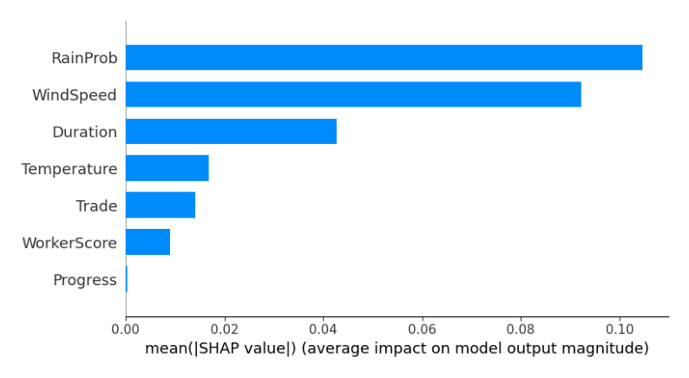
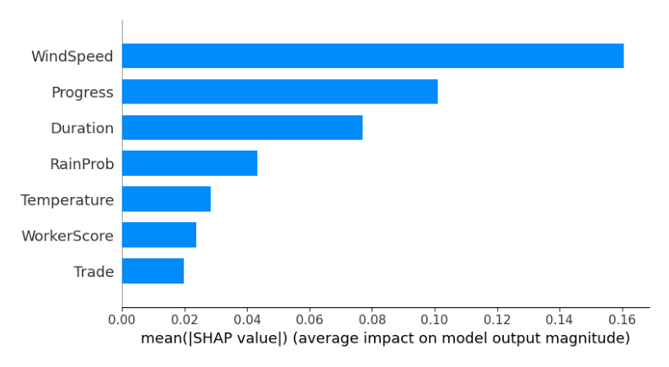
Model Feature importance
XG_Boost
MAE Train: 1.152, MAE Validation: 1.129
Random Forest
MAE Train: 1.08, MAE Validation: 1.13

Slide 13
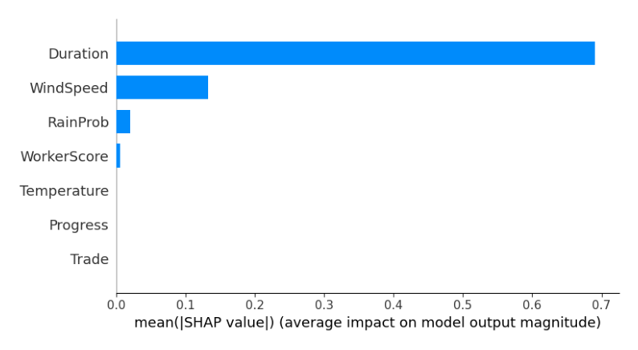
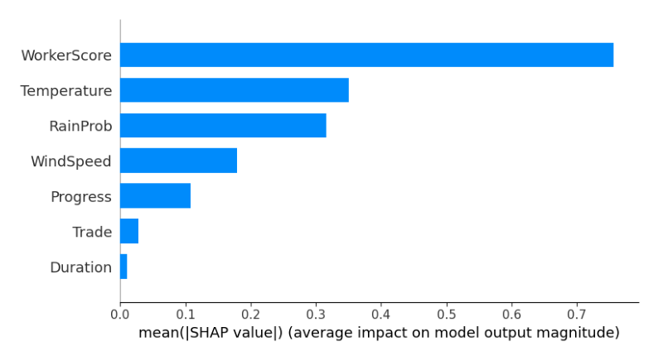
Model Feature importance
Decision Tree (failed)
MAE Train: 1.153, MAE Validation: 1.134
Multiple Layer Perceptron
MAE Train: 1.039, MAE Validation: 1.15

Slide 14
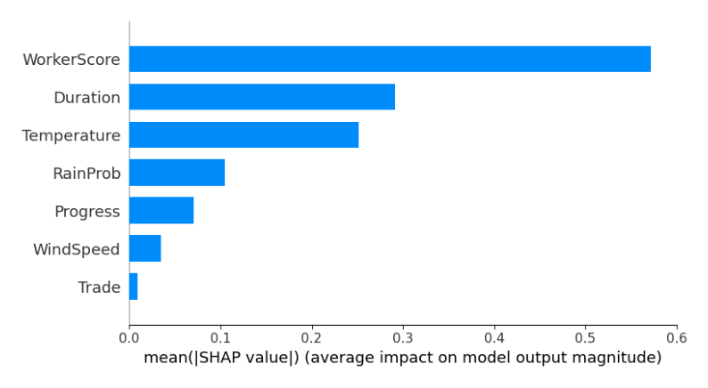
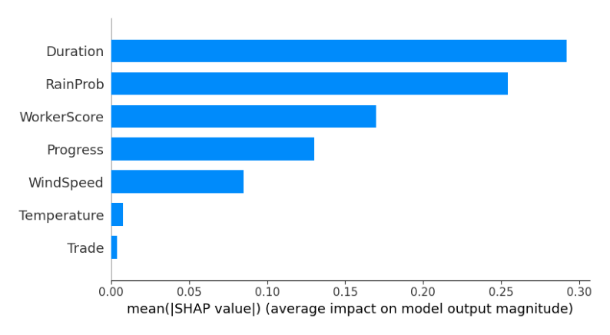
Model Feature importance
Convoluted Neural Network
MAE Train: 0.972, MAE Validation: 1.171
Long-Short Term Memory
MAE Train: 0.832, MAE Validation: 1.192

Slide 15
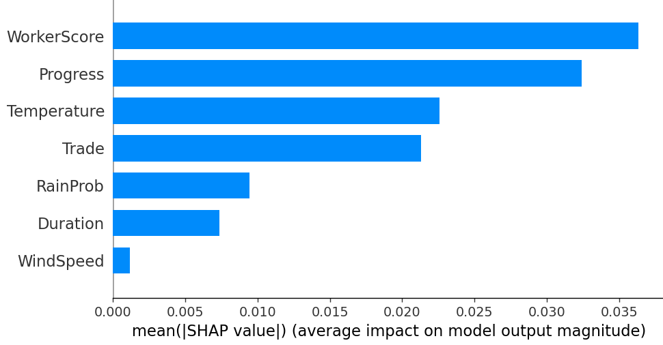
Model Feature importance
CNN + LSTM
Average MAE: 1.089 Average RMSE: 1.231

Slide 16
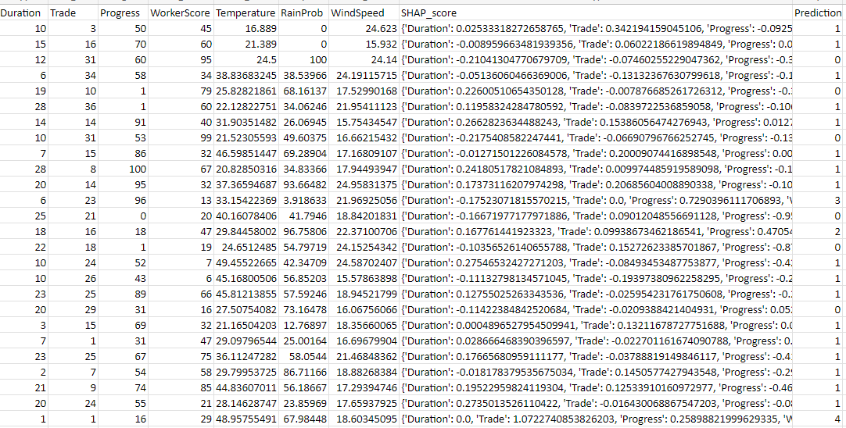
We also design some backend predict request endpoint to test our model. Example of Predicting multiple tasks at once (as an example as a whole project):

Slide 17
Right now we're already working on the Ensemble Model by combining multiple models to comply each algorithm weaknesses, next we want to generate different variation of project dataset from 0% overall progress to 90% overall progress which later on will be feed to our Ensemble Model to enter the Incremental Learning Phase so that our model can understand even more complex pattern.
Why we use incremental learning,
Our system was aimed to be always predicting the possibility of delay based on updated data overtime.
We want our AI model learns and enhances its knowledge progressively, without forgetting previously acquired information

Slide 18
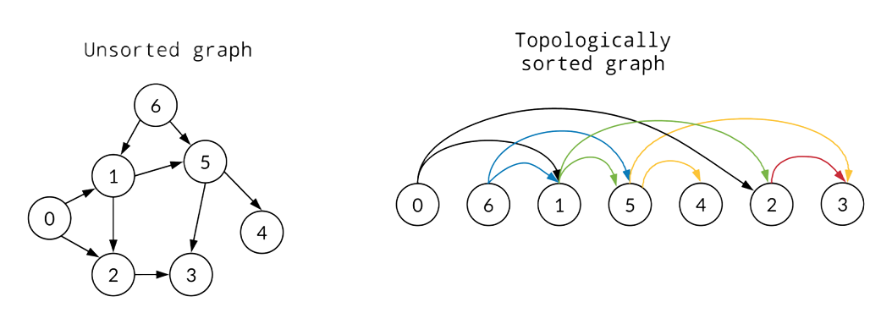
Sequencing phase
At sequencing phase, first we build the sequencing graph to identity task with successor and predecessor, then we use topological sort algorithm to sort and navigate each task starting point, from there we run a simulation based on individual task delay prediction and then aggregate them together to calculate cumulative delay for the whole project.

Slide 19
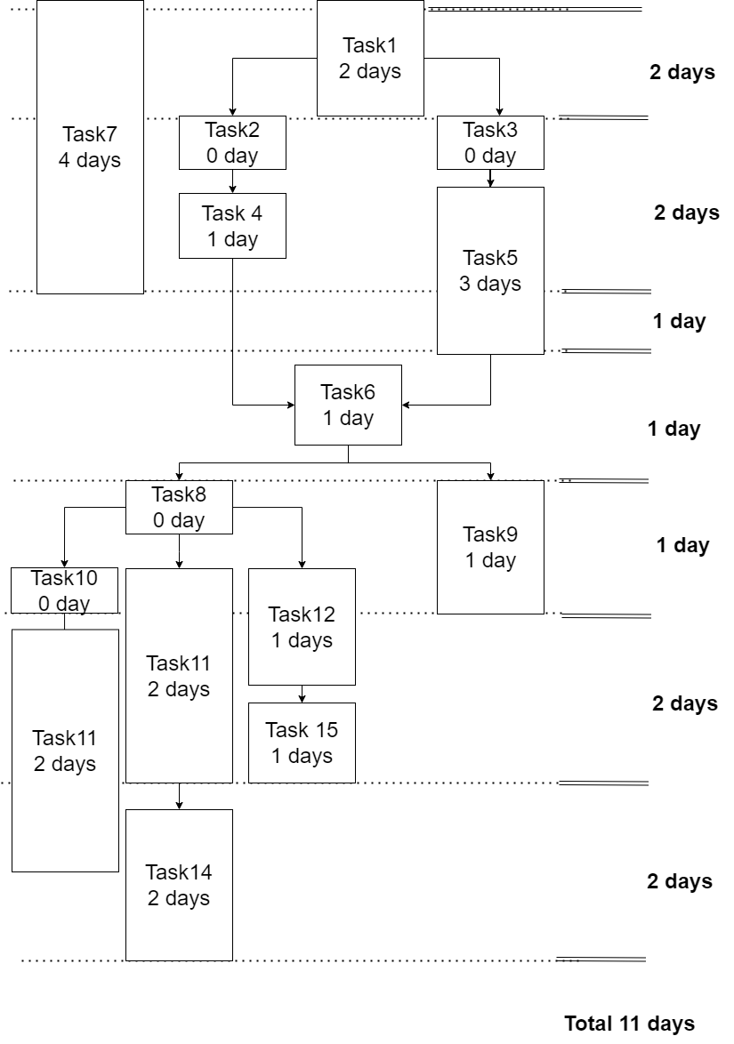
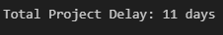
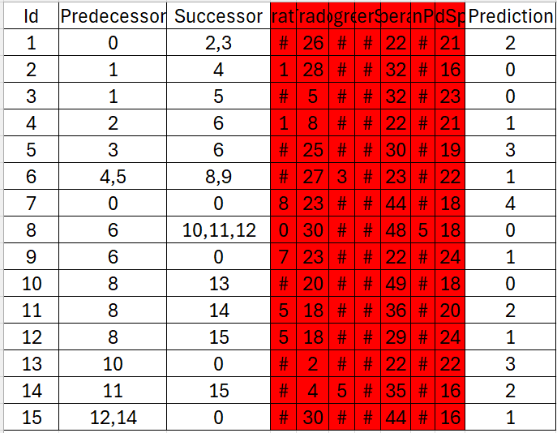
Algorithm validation
Algorithm output:
Marked red (irrelevant features for sequencing)

Slide 20
Task 1
Predecessor: None (can start immediately)
Prediction Delay: 2 days
Total delay for Task 1: 2 days
Task 2
Predecessor: Task 1
Task 1 Total Delay: 2 days
Prediction Delay: 0 days
Total delay for Task 2: 2 (from Task 1) + 0 (own) = 2 days
Task 3
Predecessor: Task 1
Task 1 Total Delay: 2 days
Prediction Delay: 0 days
Total delay for Task 3: 2 (from Task 1) + 0 (own) = 2 days
Task 4
Predecessor: Task 2
Task 2 Total Delay: 2 days
Prediction Delay: 1 day
Total delay for Task 4: 2 (from Task 2) + 1 (own) = 3 days
Task 5
Predecessor: Task 3
Task 3 Total Delay: 2 days
Prediction Delay: 3 days
Total delay for Task 5: 2 (from Task 3) + 3 (own) = 5 days
Task 6
Predecessors: Task 4 and Task 5
Maximum predecessor delay: Task 5 has the largest delay of 5 days.
Prediction Delay: 1 day
Total delay for Task 6: 5 (from Task 5) + 1(own) = 6 days

Slide 21
Task 7
Predecessor: None (starts immediately)
Prediction Delay: 4 days
Delay for Task 7: 4 days
Task 8
Predecessor: Task 6
Task 6 Total Delay: 6 days
Prediction Delay: 0 days
Total delay for Task 8: 6 (from Task 6) + 0 (own) = 6 days
Task 9
Predecessor: Task 6
Task 6 Total Delay: 6 days
Prediction Delay: 1 day
Total delay for Task 9: 6 (from Task 6) + 1 (own) = 7 days
Task 10
Predecessor: Task 8
Task 8 Total Delay: 6 days
Prediction Delay: 0 days
Total delay for Task 10: 6 (from Task 8) + 0 (own) = 6 days
Task 11
Predecessor: Task 8
Task 8 Total Delay: 6 days
Prediction Delay: 2 days
Total delay for Task 11: 6 (from Task 8) + 2 (own) = 8 days
Task 12
Predecessor: Task 8
Task 8 Total Delay: 6 days
Prediction Delay: 1 day
Total delay for Task 12: 6 (from Task 8) + 1 (own) = 7 days

Slide 22
Task 13
Predecessor: Task 10
Task 10 Total Delay: 6 days
Prediction Delay: 3 days
Total delay for Task 13: 6 (from Task 10) + 3 (own) = 9 days
Task 14
Predecessor: Task 11
Task 11 Total Delay: 8 days
Prediction Delay: 2 days
Total delay for Task 14: 8 (from Task 11) + 2 (own) = 10 days
Task 15
Predecessors: Task 12 and Task 14
Maximum predecessor delay: Task 14 has the largest delay of 10 days.
Prediction Delay: 1 day
Total delay for Task 15: 10 (from Task 14) + 1 (own) = 11 days

Slide 23
Project delay prediction output

Slide 24
THANK YOU

